Slide 1

CSE3009 - Parallel and Distributed Computing Course Type: LTP Credits: 4
Prepared by
Dr Komarasamy G
Senior Associate Professor
School of Computing Science and Engineering
VIT Bhopal University

Slide 2
INTRODUCTION TO PARALLEL COMPUTING

Slide 3
OBJECTIVES:
To introduce you to the basic concepts and ideas in parallel computing
To familiarize you with the major programming models in parallel computing
To provide you with with guidance for designing efficient parallel programs

Slide 4
OUTLINE:
Introduction to Parallel Computing / High Performance Computing (HPC)
Concepts and terminology
Parallel programming models
Parallelizing your programs
Parallel examples

Slide 5
What is High Performance Computing?

Slide 6

What is High Performance Computing?

Slide 7

What is High Performance Computing?
Odyssey supercomputer is the major computational resource of FAS RC:
2,140 nodes / 60,000 cores
14 petabytes of storage

Slide 8
What is High Performance Computing?
Odyssey supercomputer is the major computational resource of FAS RC:
2,140 nodes / 60,000 cores
14 petabytes of storage
Using the world’s fastest and largest computers to solve large and complex problems.

Slide 9
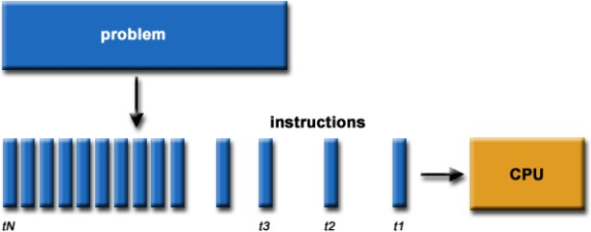
Serial Computation:
Traditionally software has been written for serial computations:
To be run on a single computer having a single Central Processing Unit (CPU)
A problem is broken into a discrete set of instructions
Instructions are executed one after another
Only one instruction can be executed at any moment in time

Slide 10
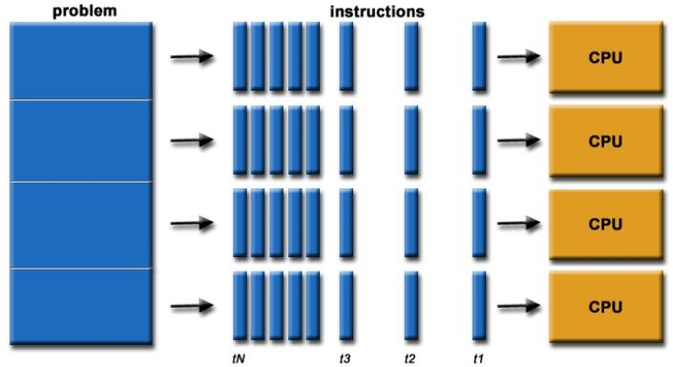
Parallel Computing:
In the simplest sense, parallel computing is the simultaneous use of multiple compute resources to solve a computational problem:
To be run using multiple CPUs
A problem is broken into discrete parts that can be solved concurrently
Each part is further broken down to a series of instructions
Instructions from each part execute simultaneously on different CPUs

Slide 11
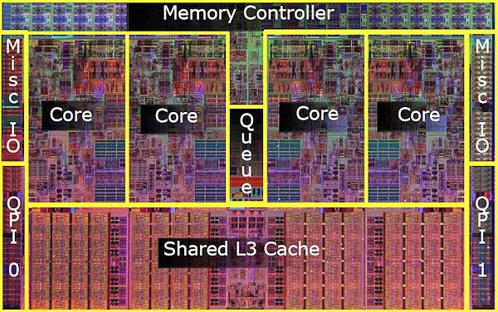
Parallel Computers:
Virtually all stand-alone computers today are parallel from a hardware perspective:
Multiple functional units (floating point, integer, GPU, etc.)
Multiple execution units / cores
Multiple hardware threads
Intel Core i7 CPU and its
major components
Image Credit: Intel

Slide 12
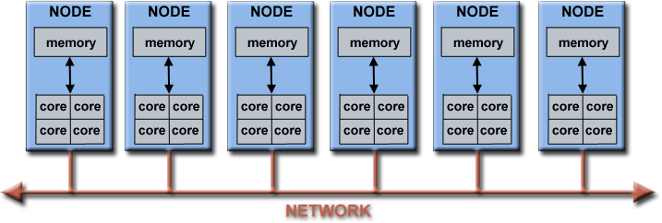
Parallel Computers:
Networks connect multiple stand-alone computers (nodes) to create larger parallel computer clusters
Each compute node is a multi-processor parallel computer in itself
Multiple compute nodes are networked together with an InfiniBand network
Special purpose nodes, also multi-processor, are used for other purposes

Slide 13




Why Use HPC?
Major reasons:
Save time and/or money: In theory, throwing more resources at a task will shorten its time to completion, with potential cost savings. Parallel clusters can be built from cheap, commodity components.
Solve larger problems: Many problems are so large and/or complex that it is impractical or impossible to solve them on a single computer, especially given limited computer memory.
Provide concurrency: A single compute resource can only do one thing at a time. Multiple computing resources can be doing many things simultaneously.
Use of non-local resources: Using compute resources on a wide area network, or even the Internet when local compute resources are scarce.

Slide 14
HPC Terminology:
Supercomputing / High-Performance Computing (HPC)
Flop(s) – Floating point operation(s)
Node – a stand alone computer
CPU / Core – a modern CPU usually has several cores (individual processing units )
Task – a logically discrete section from the computational work
Communication – data exchange between parallel tasks
Speedup – time of serial execution / time of parallel execution
Massively Parallel – refer to hardware of parallel systems with many processors (“many” = hundreds of thousands)
Pleasantly Parallel – solving many similar but independent tasks simultaneously. Requires very little communication
Scalability - a proportionate increase in parallel speedup with the addition of more processors

Slide 15
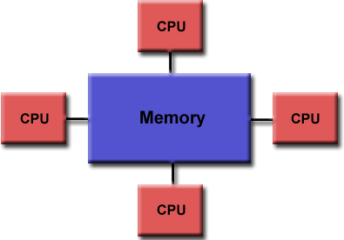
Parallel Computer Memory Architectures:
Shared Memory:
Multiple processors can operate independently, but share the same memory resources
Changes in a memory location caused by one
CPU are visible to all processors

Slide 16
Parallel Computer Memory Architectures:
Shared Memory:
Multiple processors can operate independently, but share the same memory resources
Changes in a memory location caused by one
CPU are visible to all processors
Advantages:
Global address space provides a user-friendly programming perspective to memory
Fast and uniform data sharing due to proximity of memory to CPUs
Disadvantages:
Lack of scalability between memory and CPUs. Adding more CPUs increases traffic on the shared memory-CPU path
Programmer responsibility for “correct” access to global memory

Slide 17
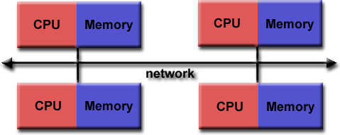
Parallel Computer Memory Architectures:
Distributed Memory:
Requires a communication network to connect inter-processor memory
Processors have their own local memory. Changes made by one CPU have no effect on others
Requires communication to exchange data among processors

Slide 18
Parallel Computer Memory Architectures:
Distributed Memory:
Requires a communication network to connect inter-processor memory
Processors have their own local memory. Changes made by one CPU have no effect on others
Requires communication to exchange data among processors
Advantages:
Memory is scalable with the number of CPUs
Each CPU can rapidly access its own memory without overhead incurred with trying to maintain global cache coherency
Disadvantages:
Programmer is responsible for many of the details associated with data communication between processors
It is usually difficult to map existing data structures to this memory organization, based on global memory

Slide 19
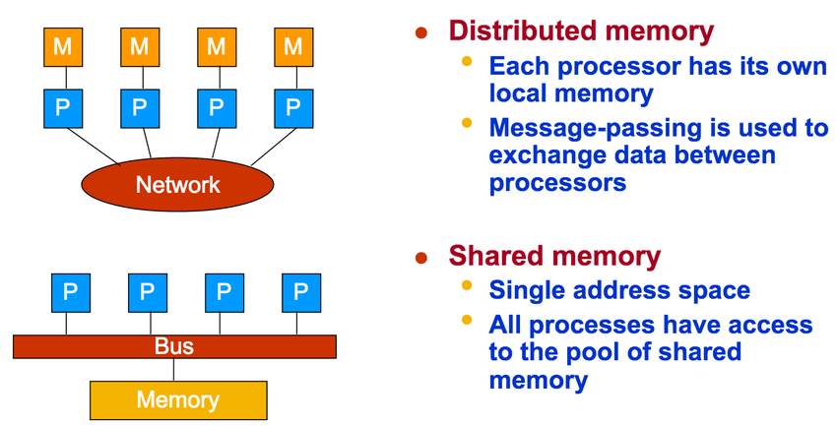
Shared vs Distributed memory

Slide 20
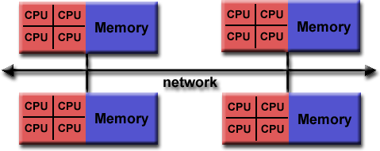

Parallel Computer Memory Architectures:
Hybrid Distributed-Shared Memory:
The largest and fastest computers in the world today employ both shared and distributed memory architectures.
Shared memory component can be a shared memory machine and/or GPU
Processors on a compute node share same memory space
Requires communication to exchange data between compute nodes

Slide 21
Parallel Computer Memory Architectures:
Hybrid Distributed-Shared Memory:
The largest and fastest computers in the world today employ both shared and distributed memory architectures.
Shared memory component can be a shared memory machine and/or GPU
Processors on a compute node share same memory space
Requires communication to exchange data between compute nodes
Advantages and Disadvantages:
Whatever is common to both shared and distributed memory architectures
Increased scalability is an important advantage
Increased programming complexity is a major disadvantage

Slide 22
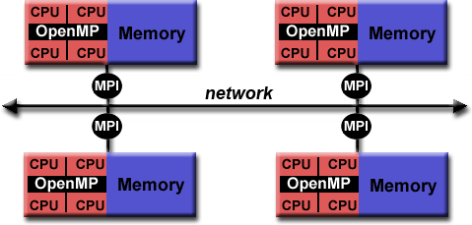
Hybrid Parallel Programming Models:
Currently, a common example of a hybrid model is the combination of the message passing model (MPI) with the threads model (OpenMP)
Threads perform computationally intensive kernels using local, on-node data
Communications between processes on different nodes occurs over the network using MPI
This hybrid model lends itself well to the increasingly common hardware environment of clustered multi/many-core machines

Slide 23
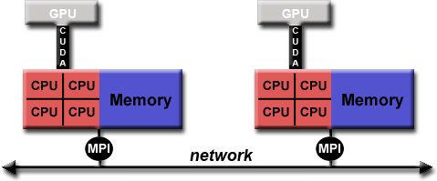
Hybrid Parallel Programming Models:
Another similar and increasingly popular example of a hybrid model is using MPI with GPU (Graphics Processing Unit) programming
GPUs perform computationally intensive kernels using local, on-node data
Communications between processes on different nodes occurs over the network using
MPI

Slide 24
Designing parallel programs - communication:
Most parallel applications require tasks to share data with each other.
Cost of communication: Computational resources are used to package and transmit data. Requires frequently synchronization – some tasks will wait instead of doing work. Could saturate network bandwidth.
Latency vs. Bandwidth: Latency is the time it takes to send a minimal message between two tasks. Bandwidth is the amount of data that can be communicated per unit of time. Sending many small messages can cause latency to dominate communication overhead.
Synchronous vs. Asynchronous communication: Synchronous communication is referred to as blocking communication – other work stops until the communication is completed.
Asynchronous communication is referred to as non-blocking since other work can be done while communication is taking place.

Slide 25
Languages using parallel computing:
C/C++
Fortran
MATLAB
Python
R
Perl
Julia
And others

